Slide 1

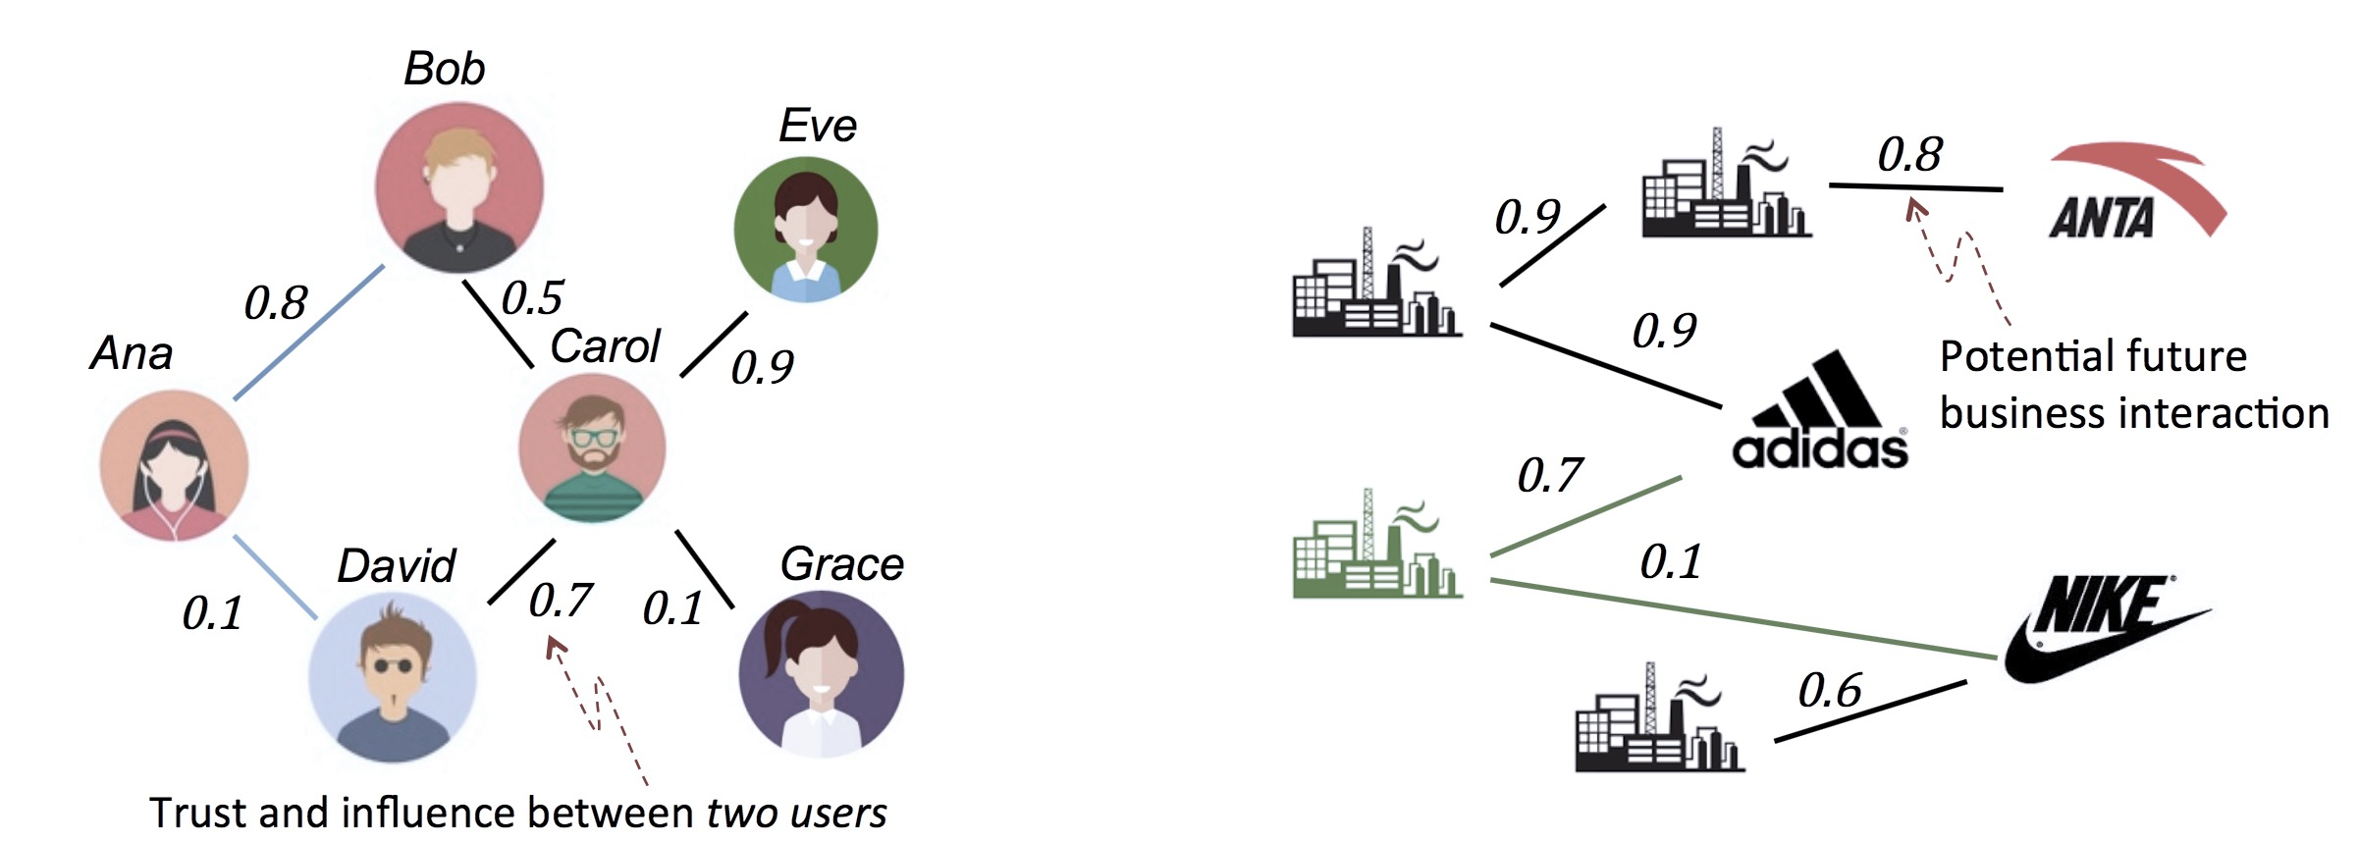
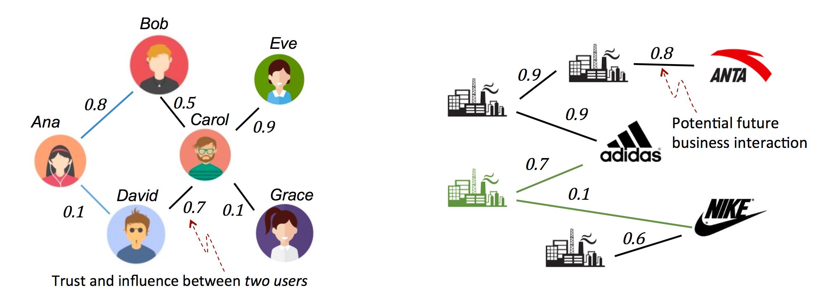

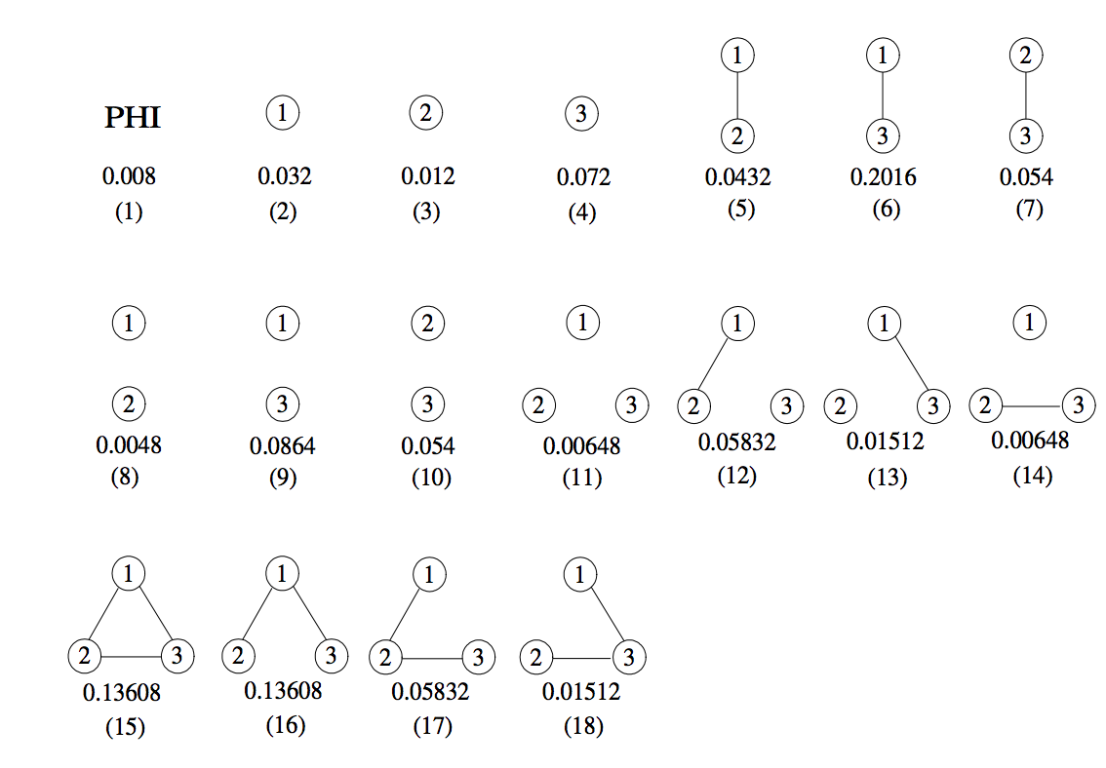
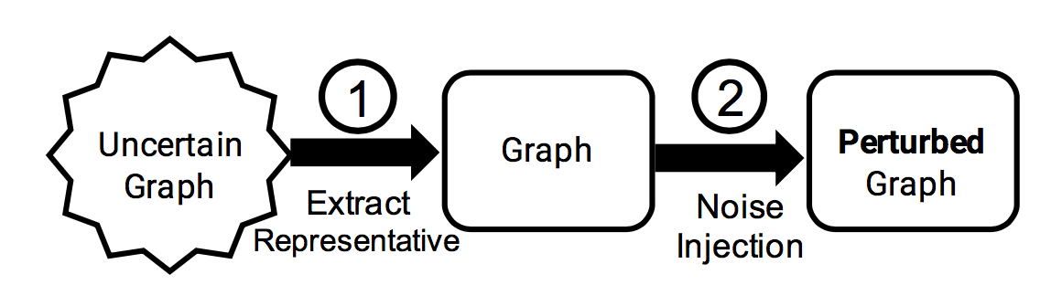

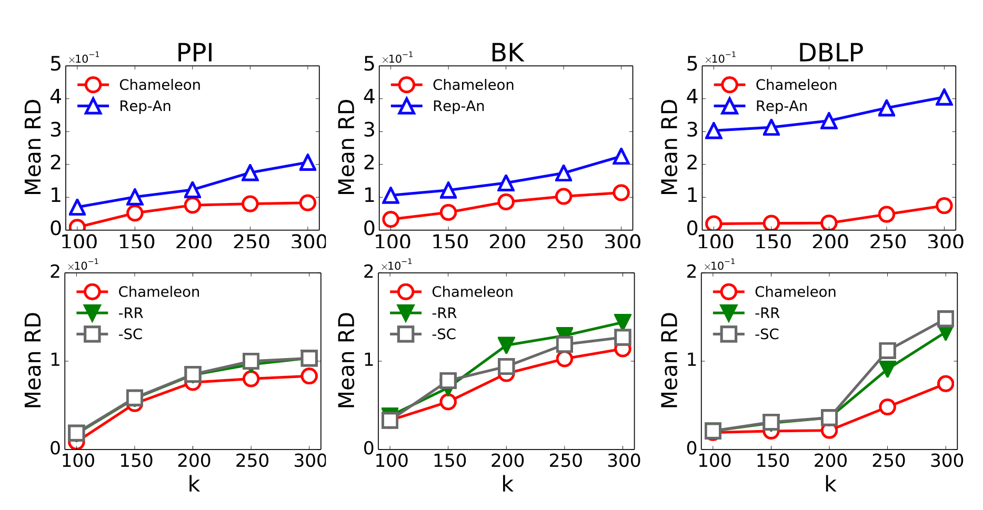
Sharing Uncertain Graphs Using Syntactic
Private Graph Model
Dongqing Xiao, Mohamed Eltabakh, Xiangnan Kong
Worcester Polytechnic Institute, USA
dxiao, meltabakh,xkong@wpi.edu
Objective: Sharing Uncertain Graphs
Challenges
Stochastic Privacy Attack
Stochastic Utility Loss
Intractable Search Space
Leak caused by edge uncertainty
Structural difference over uncertain graphs
Exponential
search space
Data
Social Interaction Study Theory Validation
Micro-targeting Virtual Marketing
Chameleon: Uncertain Graph Anonymization Solution
Concern: Privacy Breach
Baseline Approach: Rep-An
Combines isolated techniques
Suffers from huge utility loss
With the possible world semantics
Enables a fine- grained control of injected noise
Data
max
1.
Heuristic Evaluation
Utility Relevance (RR)
User Privacy Breach Business Model Leak
Guided Random Search
mid
2.
Random
Sampling
Privacy Vulnerability (SC)
Option: Anonymization
min
3.
Selection
(k-anonymity variant)
Binary search
the minimal amount of necessary noise
Uncertain Graph
Empirical Evaluation
Weighted Graph
@ possible world semantic
Rep-An: Baseline Approach
SC: Stochastic Controlled Heuristic
RR: Reliability Relevance Heuristic
The simplest case: edge independent
Current graph anonymization techniques only target deterministic graphs and overlook the uncertain scenario.
The generated anonymized uncertain graphs
that closely match the original ones w.r.t Reliability .

